Slide 1
Plasma Membrane
Balqees K. Hassan

Slide 2
Objectives
Structure of PM
Function of PM

Slide 3
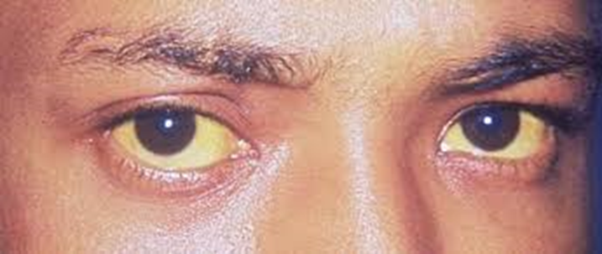
Ayad, a 16-year-old boy, has consulted the hospital for pallor and yellowish discoloration of the eyes.
After clinical examination and performing some lab tests the doctor told his mother that he has hereditary spherocytosis (a blood disease that result from abnormal fragile RBCs with short life span due to defective cell membrane function).

Slide 4
Plasma membrane can be defined as a thin semi permeable membrane layer that separates the interior of all cells from the outside environment (the extracellular space) and regulates the materials that enter and exit the cell.

Slide 5
The plasma membrane thickness is ranged between 7.5 to 10 nm.
visible only in the electron microscope.
The line that can seen under L.M. some times is formed by P.M. proteins of the cells and extracellular material.

Slide 6
Structure of plasma membrane
plasma membrane is a mosaic or its composed of phospholipids, cholesterol molecules, proteins and carbohydrates.
Lipids can make up from 20 to 80 percent of the membrane, with the remainder being proteins.

Slide 7
Lipids help to give membranes their flexibility.
Proteins assist in the transfer of molecules across the membrane.

Slide 8
Phospholipids
Phospholipids(lipids contain the element phosphorus) make up the basic structure of a cell membrane.
Each phospholipid molecule has two different ends: a head and a tail.

Slide 9
The head end contains a phosphate group and is hydrophilic or water- attracting.
The tail end is made up of two strings of hydrogen and carbon atoms called fatty acid chains.

Slide 10
These chains are hydrophobic or water-repelling do not like to mix with water molecules.

Slide 11
The phospholipids of a cell membrane are arranged in a double layer called the lipid bilayer
The hydrophilic phosphate heads are always arranged so that they are near water.
The hydrophobic tails of membrane phospholipids are organized in a manner that keeps them away from water.

Slide 12
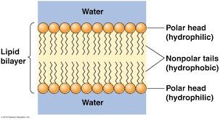
Arrangement of phospholipid molecules makes up the lipid bilayer

Slide 13
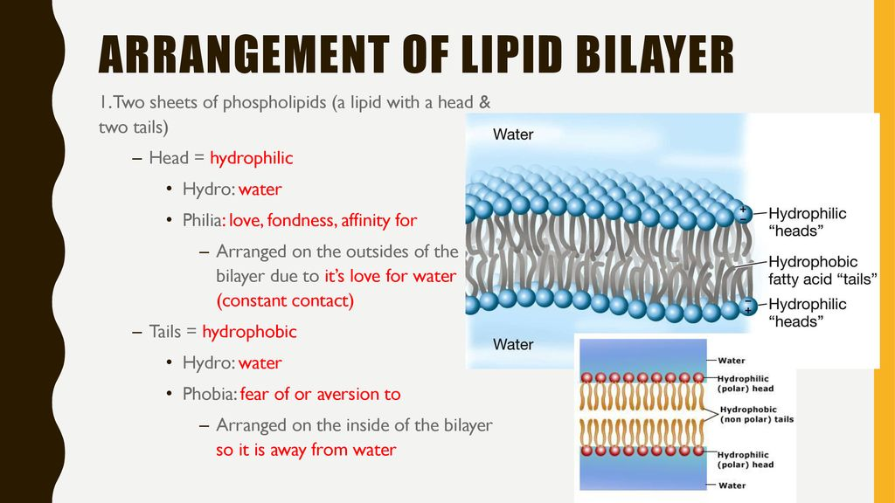
Arrangement of phospholipid molecules makes up the lipid bilayer.

Slide 14
Cholesterol
Is a very important component of cell membranes, often at nearly 1:1 ratio with the phospholipids in plasma membrane.
Cholesterol molecules are made up of four rings of hydrogen and carbon atoms.

Slide 15
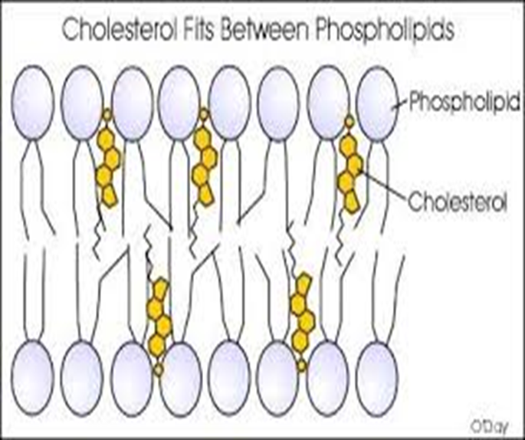
They are hydrophobic and are found among the hydrophobic tails in the lipid bilayer.

Slide 16
Cholesterol molecules are important for:
Maintaining the consistency of the cell membrane.
keep the phospholipid tails from coming into contact and solidifying.
They strengthen the membrane. Who is that?
by ensures that the cell membrane stays fluid and flexible.

Slide 17
proteins
There are two main types of protein in P.M
1-Integral proteins are located in the lipid bilayer, penetrate the hydrophobic core and often span or extent through the membrane.

Slide 18
1-Integral proteins
They have polar amino acid side chains associated with water molecules and nonpolar regions in the interior associated with nonpolar fatty acid chain.

Slide 19
1-Integral proteins
Some integral proteins span the membrane one time, they are called one-pass transmembrane proteins .
Other integral proteins span the membrane more times , they are called multi-pass transmembrane proteins.

Slide 20
2-Peripheral proteins
They are outside of the lipid bilayer.
Can be found on either side of the lipid bilayer.
Not associated with nonpolar region of the lipids bilayer.

Slide 21
The Functions and importance of proteins
Membrane proteins which are located in specialized patches of membrane can function as enzymes to speed up chemical reactions.
Structural proteins (linkers) help to give the cell support and shape.

Slide 22
Receptor proteins help cells to communicate with their external environment ,by ?
use of hormones , neurotransmitters, and other signaling molecules.
Transport proteins transport molecules across cell membranes through facilitated diffusion.

Slide 23
Channels pores in the membrane that allow speciﬁc substances to enter or leave.
Certain ions travel through channels in the membrane.
Glycoproteins which is embedded in P.M. help in cell to cell communications and molecule transport across the membrane.

Slide 24
Carbohydrates
Found attached to proteins or lipids on the outside of a cell membrane.
They are important components of specific molecules called receptors.
Together these carbohydrates form the glycocalyx which act as a glue to attach cells together.

Slide 25
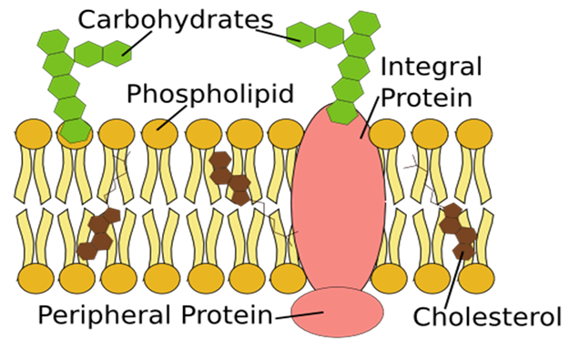
This is the fluid mosaic model of a cell membrane.

Slide 26
Functions of plasma membrane
Separates the components of the cell from its outside environment.
Regulates what enters and exits the cell.
Allows only selected substances into the cell and keeps others out.

Slide 27
Functions of plasma membrane
Protecting the integrity of the interior of the cell.
Supports the cell and helps in maintaining the shape of the cell.

Slide 28
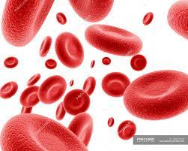
Hereditary spherocytosis
Is a condition that affects red blood cells .
Mutation in RBC cell membrane proteins result in rigid , shortage spherical or misshapen cell instead of flattened disc shape .

Slide 29
Hereditary spherocytosis
Also in normal RBC cells proteins that make the cell membrane maintain the cell structure and some of these proteins allow the cell to change shape without breaking when traveling from large to small blood vessels.

Slide 30
Hereditary spherocytosis
In spherocytosis the dysfunctional membrane proteins interfere with the cells ability to change shape when passing through different blood vessels.
As a result in spherocytosis the misshapen RBC cells are removed from circulation and taken to the spleen for destruction.

Slide 31
Conclusion
The plasma membrane or cytoplasmic membrane is a biological membrane that separates the interior of all cells from the outside environment.
The P.M. is not only encloses the cell contents, the cell membrane is also found to enclose the nuclear components.

Slide 32
Primarily composed of a mix of proteins and lipids.
lipids help to give membranes their flexibility.
Proteins monitor and maintain the cell's chemical climate and assist in the transfer of molecules across the membrane.

Slide 33
Plasma membrane is a mosaic of :
Phospholipids
Cholesterol molecules
Proteins
Carbohydrates.

Slide 34
Plasma membrane has many functions such as protecting the integrity of the interior of the cell and other functions.

Slide 35


